Slide 1
Merchant Churn Rate and Engagement
Ida Bagus Putra Anandya

Slide 2
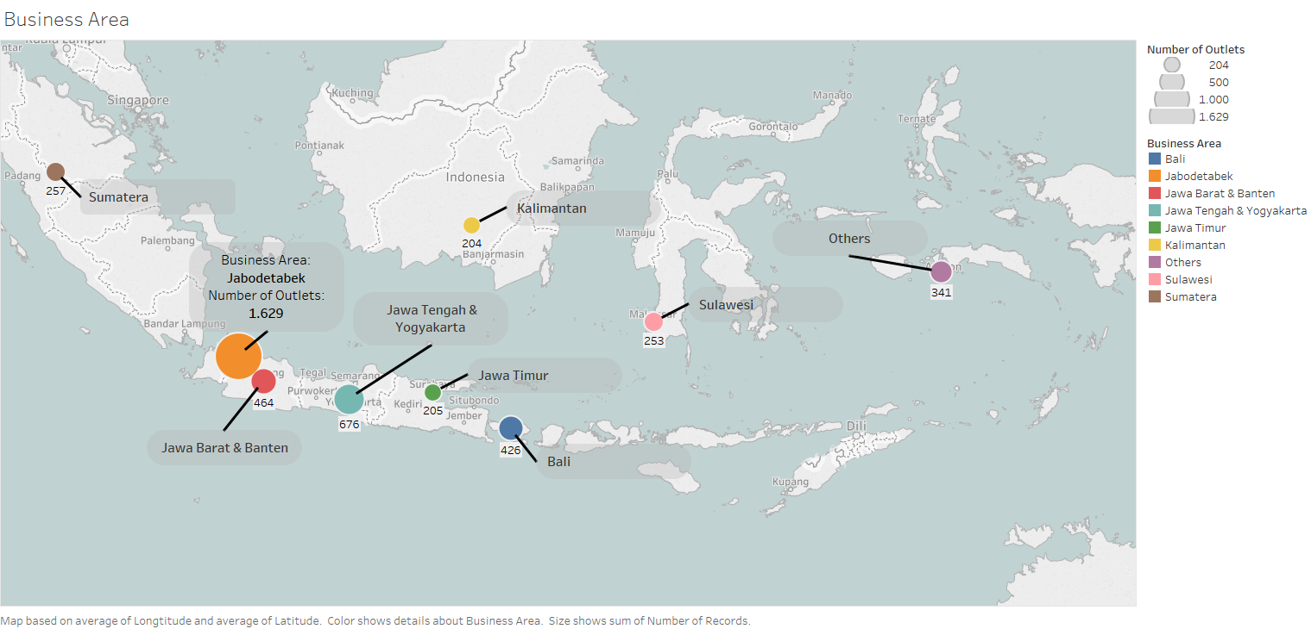

Slide 3
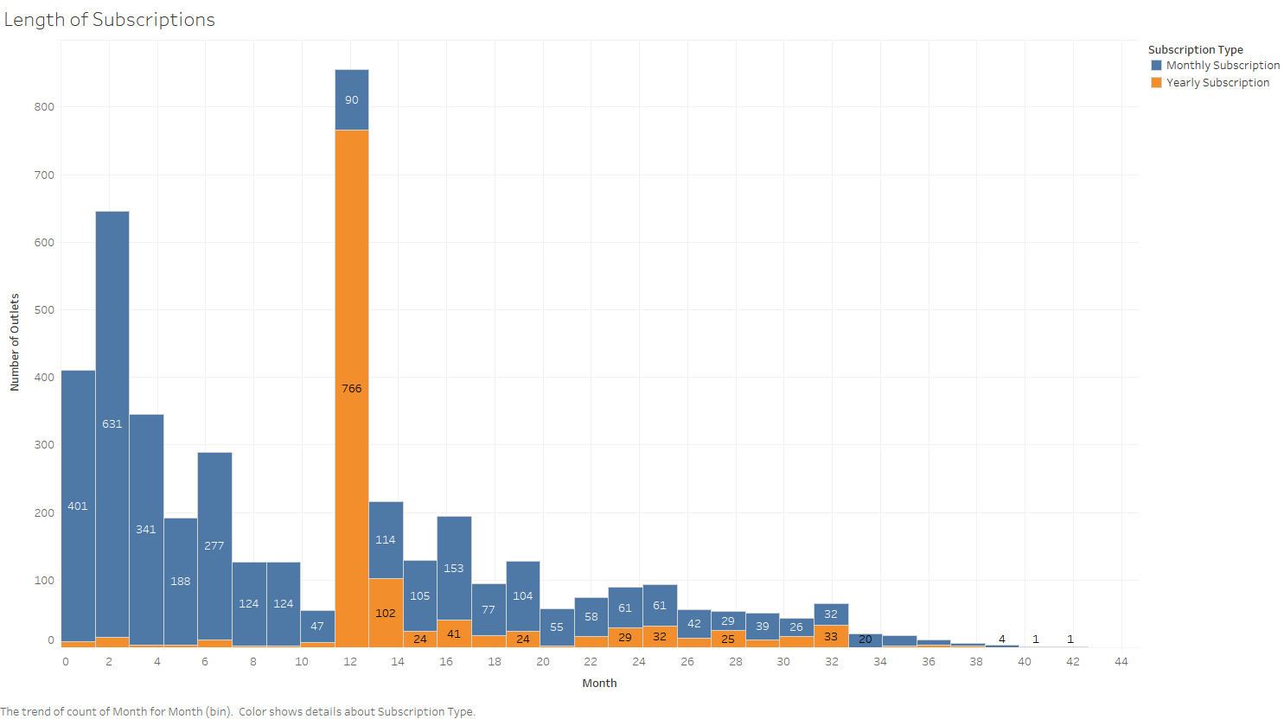

Slide 4
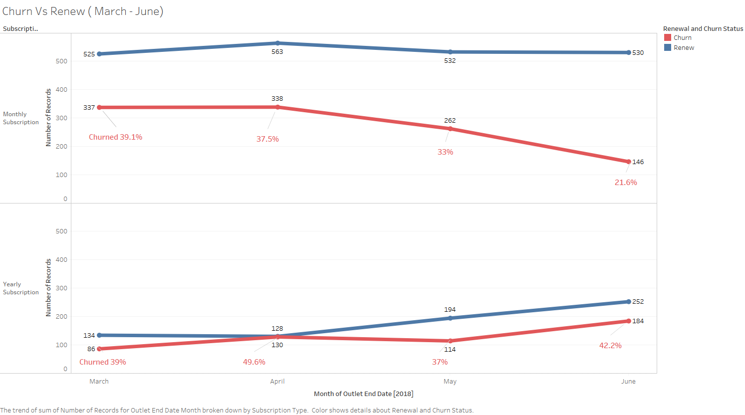

Slide 5
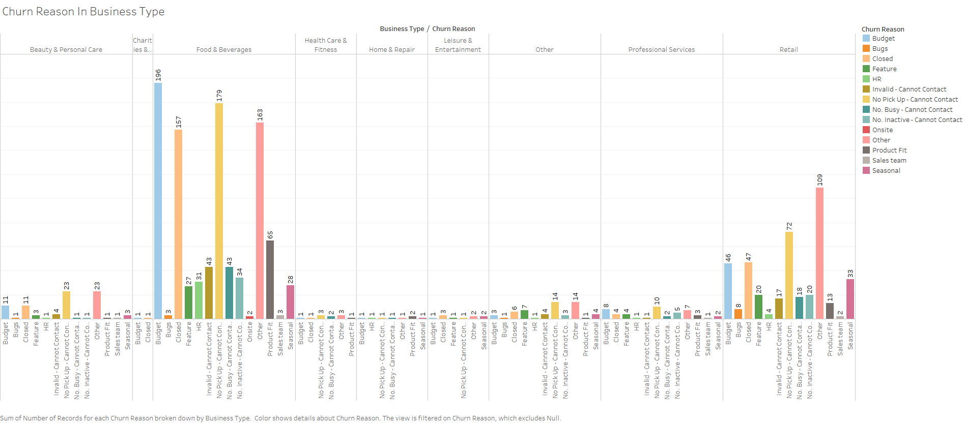

Slide 6
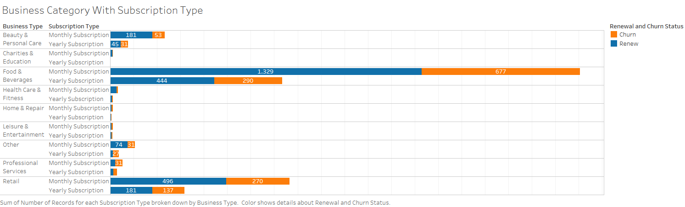
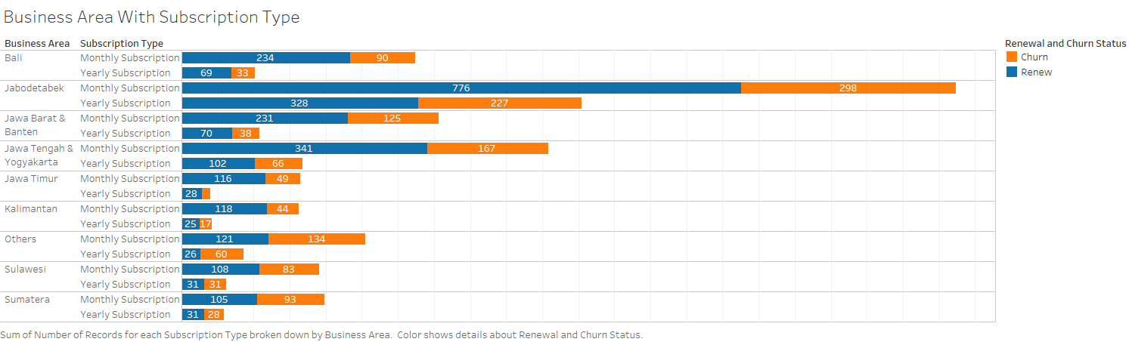

Slide 7
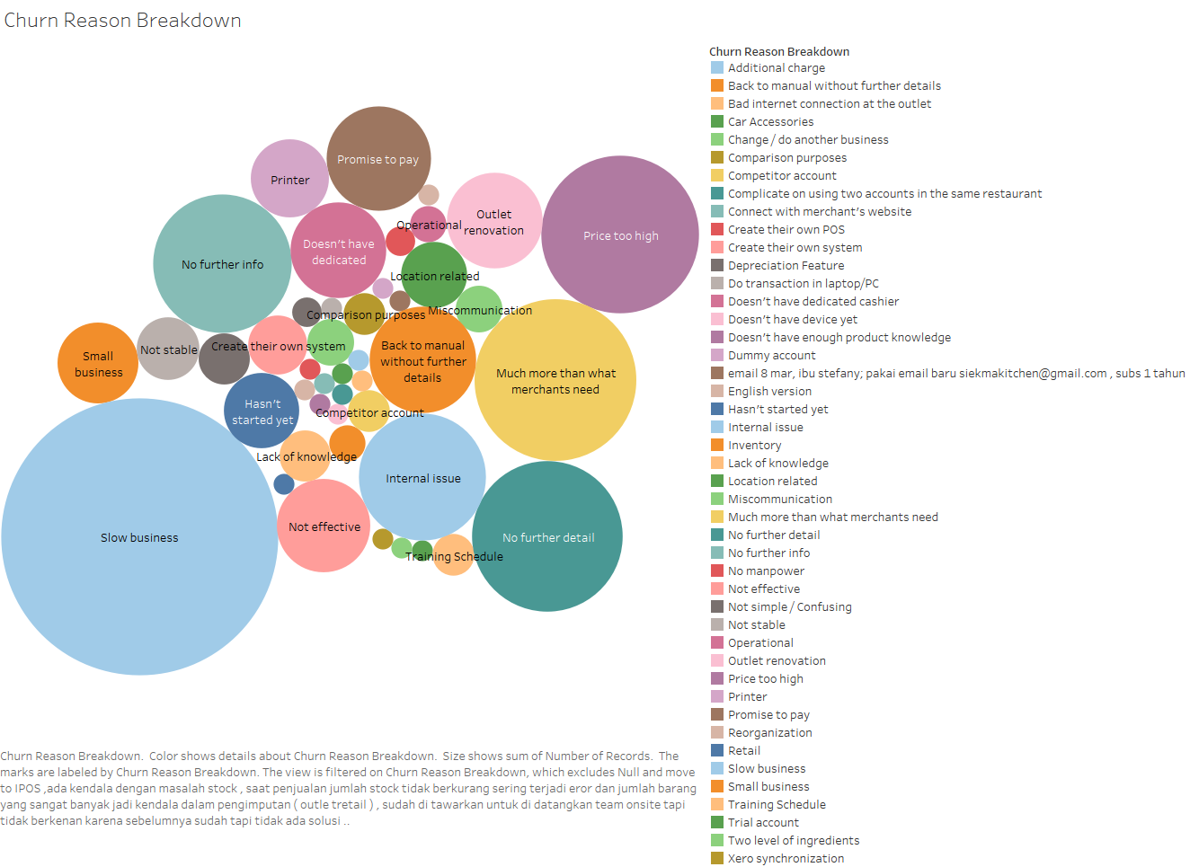

Slide 8
Make It Easier for Customers to Buy More

Slide 9
Learn more from the most loyal customers
Most companies work hard to determine the root causes of customer dissatisfaction
Create effective mechanisms for staying in close touch
If customers are happy because of product quality, what do they cite as evidence?
Interviewing a sample of clients who have convinced others to bring business to the firm

Slide 10
Tune offerings to meet their needs
Getting to know our most loyal customers will likely reveal both strengths and weaknesses in the product line
Offerings should be so attractive to your loyalists that they have no reason to look elsewhere for additional products or services

Slide 11
Focusing on the Right Customers
Identifying which customers to attract and which to avoid
Moka POS is not only selling technologies but also giving services
Customers are seeking convenience above all else
Customers are willing to pay more for that convenience

Slide 12
Key Drivers of Loyalty
Order Fulfillment
Product Performance
Post sale Service and Support

Slide 13
Engage with customers through use cases and benefits instead of functionalities and features
Customer research, which tests the appeal of various use cases and often uncovers new ones
Insight development, which explores beyond the functional benefits of use to identify the higher-order, more valuable ones
Positioning work and communications framing, which determines how best to convey those uses and benefits to customers compellingly

Slide 14
Identifying Right KPI
Revenue Persistency Metric
The share of revenue that continues more than certain months after a sale
Redirected reps from “hunting” to “farming”: improving the onboarding process and maintaining the customer relationship

Slide 15
Setting the Targets
Frequently changing the target responding to the market
Experimenting by quarterly, semesterly or yearly
Revise them too frequently, and your administrative costs and communication challenges increase
Revise them too slowly, and you may lose responsiveness to market changes and undermine reps’ engagement

Slide 16
Sales Barriers
Resistance to the sale typically occurs later in the process for new innovations than for established products
Customers don’t like open-ended situations, which create uncertainty and raise doubt
Customers continue to focus on risk and how people in the organization will be affected, worry that they will regret a decision to buy
Customers wonder whether they can accurately predict their switching costs

Slide 17
Salespeople selling new products spend 32% more face-to-face time with customers.
*Harvard Business Review November December Issue 2018

Slide 18
Sales Training
As the company grew, individual sales approaches were wildly different
Training when a product is launched can be merely a product showcase in disguise
Not only must the salesperson provide the right product information, but customers must feel they have the right information
The salesperson must help the customer understand, assess, and manage the risks and the people issues associated with change

Slide 19
Include Leaders In practice Sessions
Salespeople need their leaders to model success for them
When employees view their leaders as empowering and capable, they work more proactively
Increase bonding between leaders and sales representatives

Slide 20
Make Practice Harder than the Sale Itself
Make practice harder than a real sales call so salespeople are prepared for any conversation
Don’t help them when they get stuck
Ask follow-up questions until they find solutions themselves
When sales reps practice hard sales calls without the pressure of having a client on the line, they’re working to fight off an automatic negative response to tough questions.

Slide 21
Practice the entire sales cycle, not just the first call
Spend time going over the follow-up message, the second sales call, and every call after
Great sales teams excel in all interactions
Make sure the sales reps ready for every stage
Include even the best reps in practice and coaching efforts
Revise, revise and revise

Slide 22
Conclusion
Develop the entire customer experience ecosystem with excellent salesmanship
In the end, loyalty is not won with technology. It is won through the delivery of a consistently superior customer experience.

